Slide 1


Introduction to AI and ML
Dr. Shailesh Sivan

Slide 2
Overview
Confused?
What is machine learning?
Programming vs Learning
Machine Learning Pipeline
When to use Machine Learning?
ML Application
Types of Learning

Slide 3
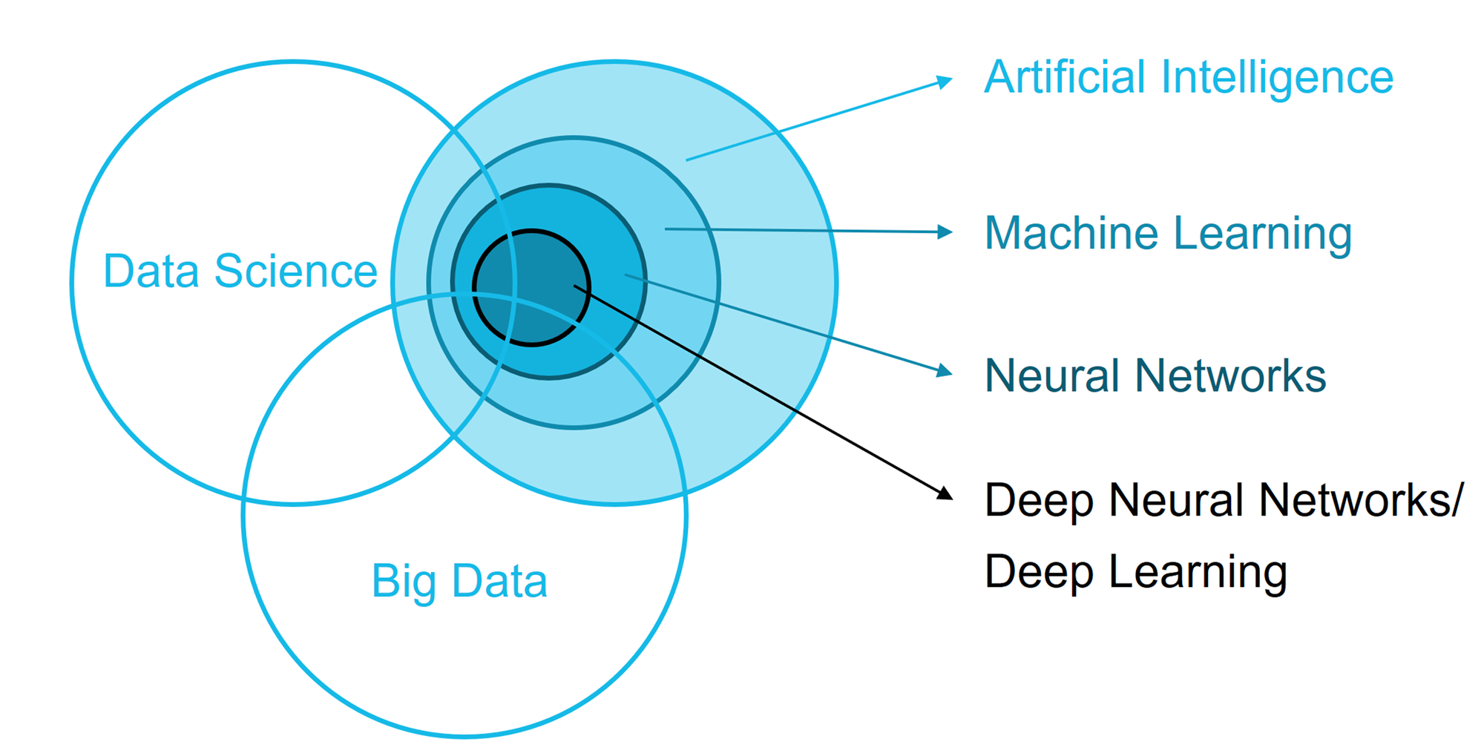
Confused ?

Slide 4
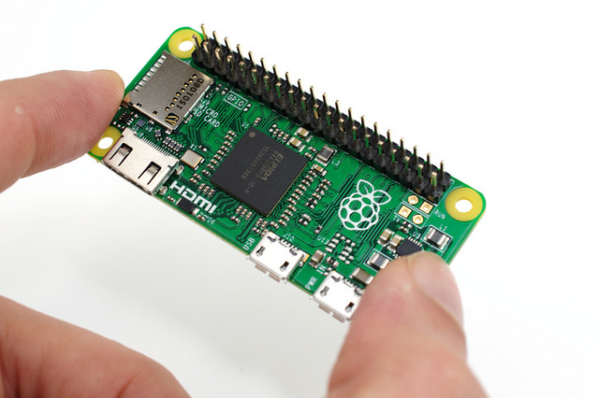
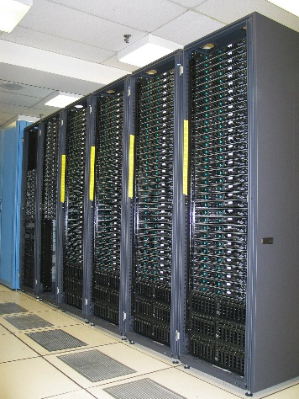

Computer Systems
One which do computing
An electronics device
Capable of storing and processing data
Can be used for controlling other devices

Slide 5
Robots and Computer
Are Computers Intelligent or Dumb ?
COMPUTERS ARE DUMB ☹ !
Computer is not a magical device.
It performs only those works which man can does
But with very high speed and reliable accuracy.
It has no any intelligence quality or thinking power

Slide 6
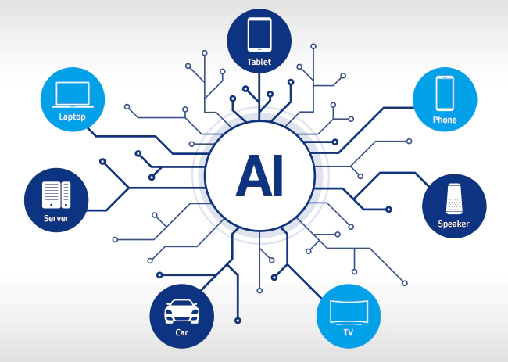
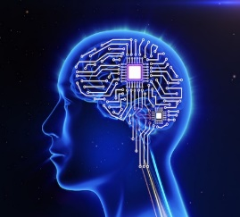
Artificial Intelligence
Can We make Computers Intelligent ?
Yeah Of course !
+ Knowledge = Artificial Intelligence
Artificial Intelligence is a scientific domain that’s deals with making intelligence to system
To make a system “think like a human”

Slide 7
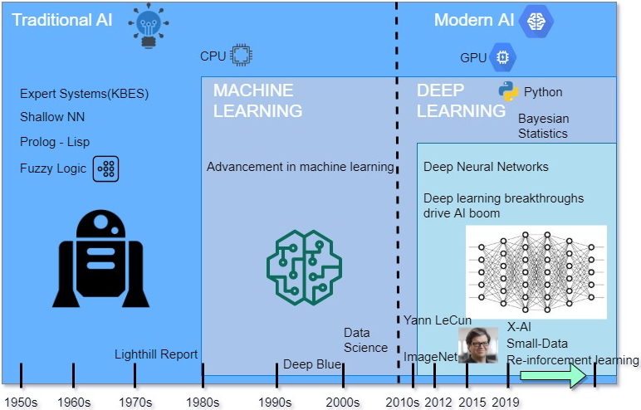
Artificial Intelligence

Slide 8
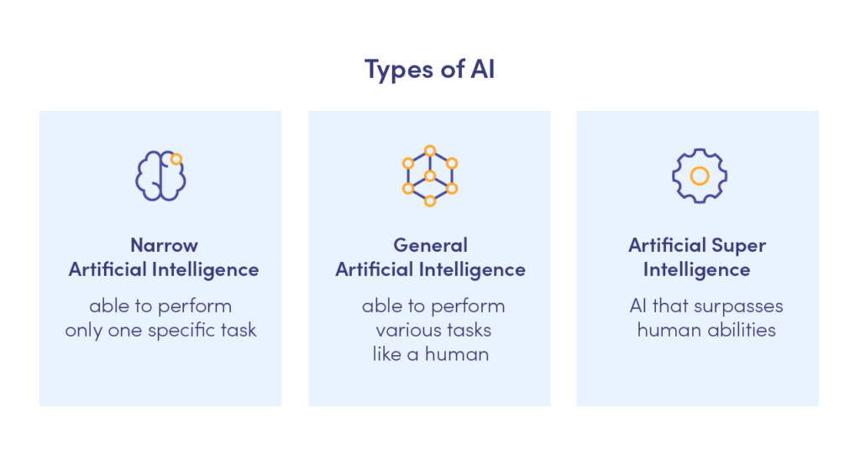
Artificial Intelligence

Slide 9
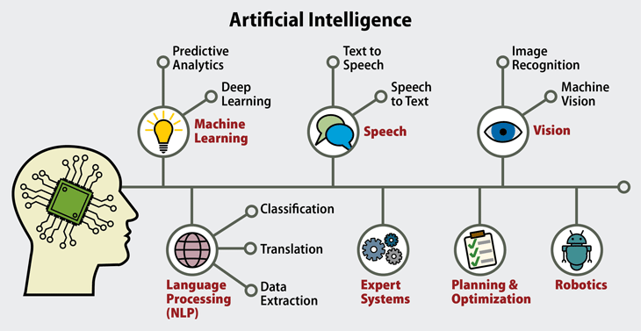

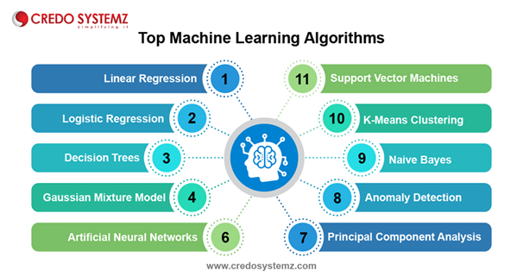

Slide 10
Confused ?

Slide 11
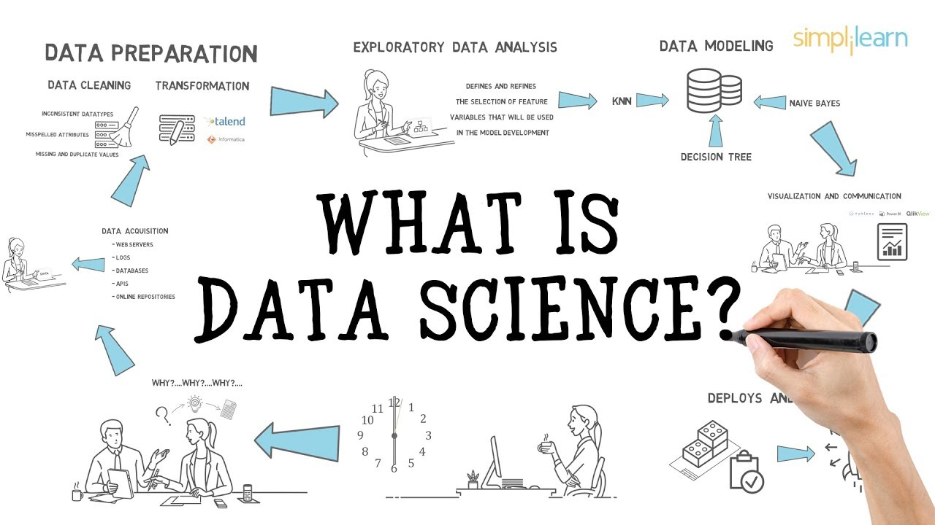
Data Science

Slide 12
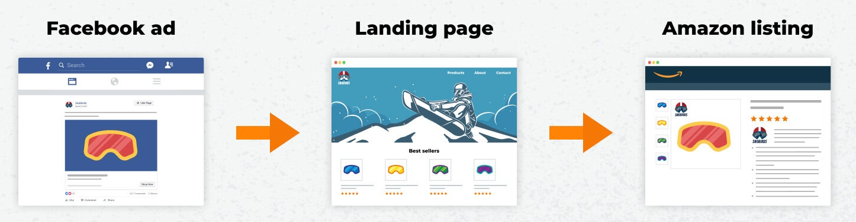
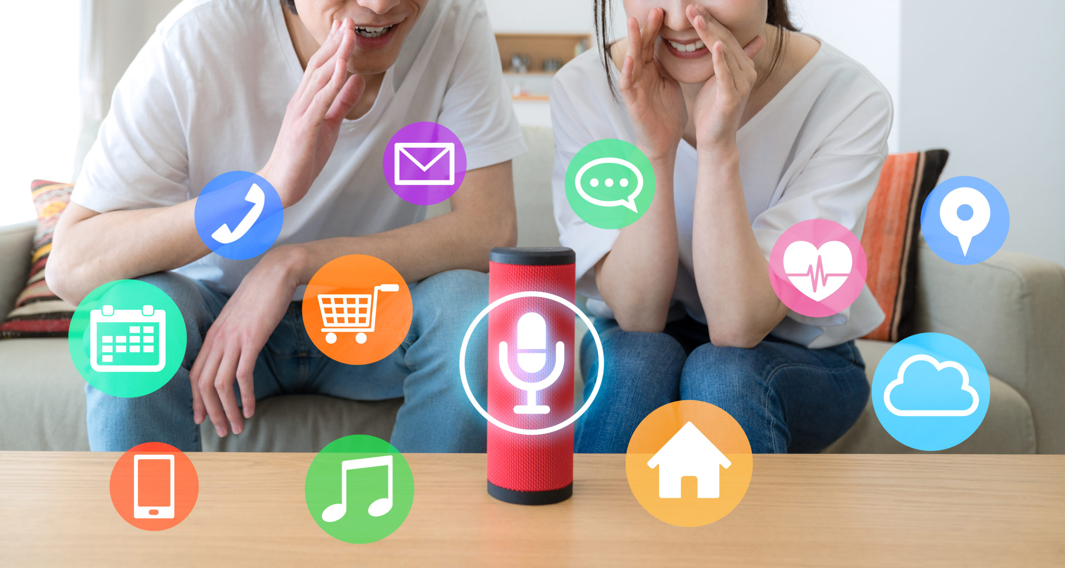
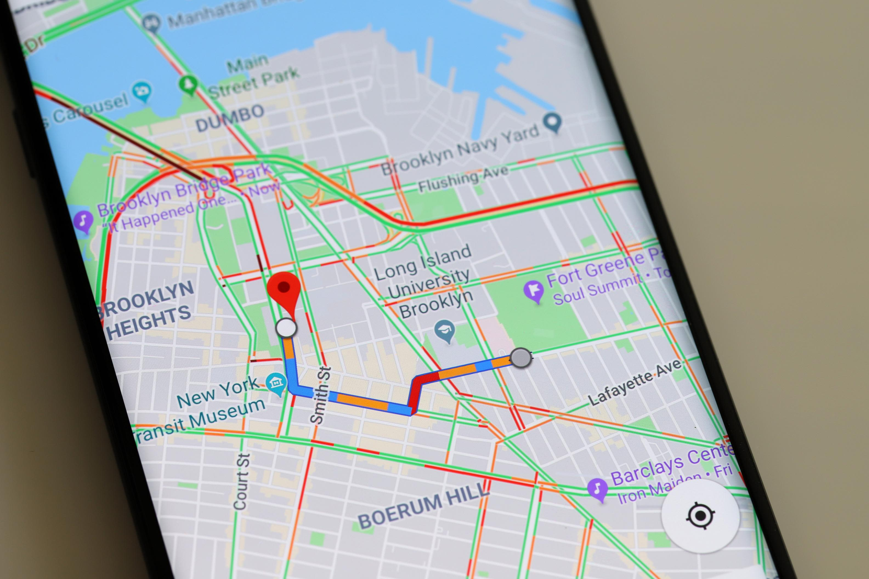
IS Data IMPOTANT?

Slide 13
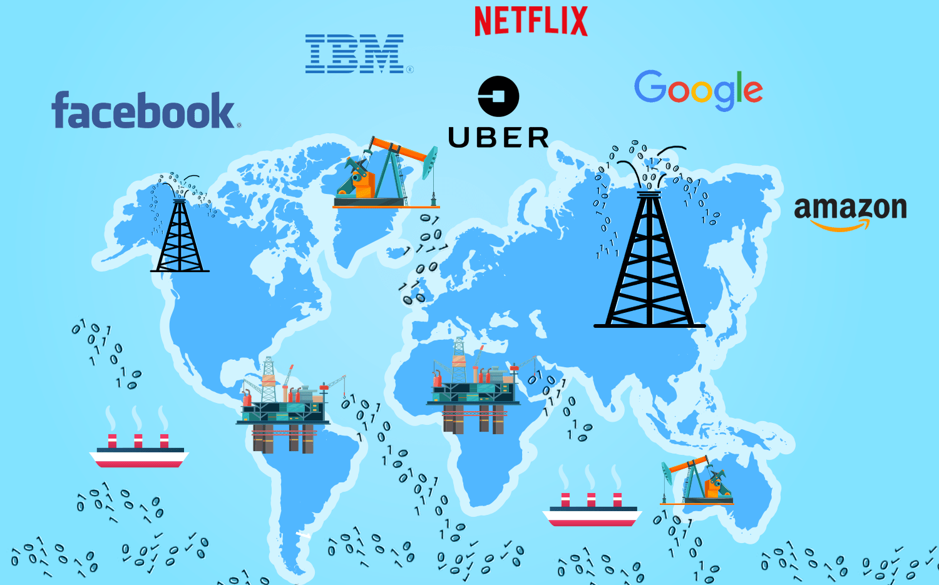
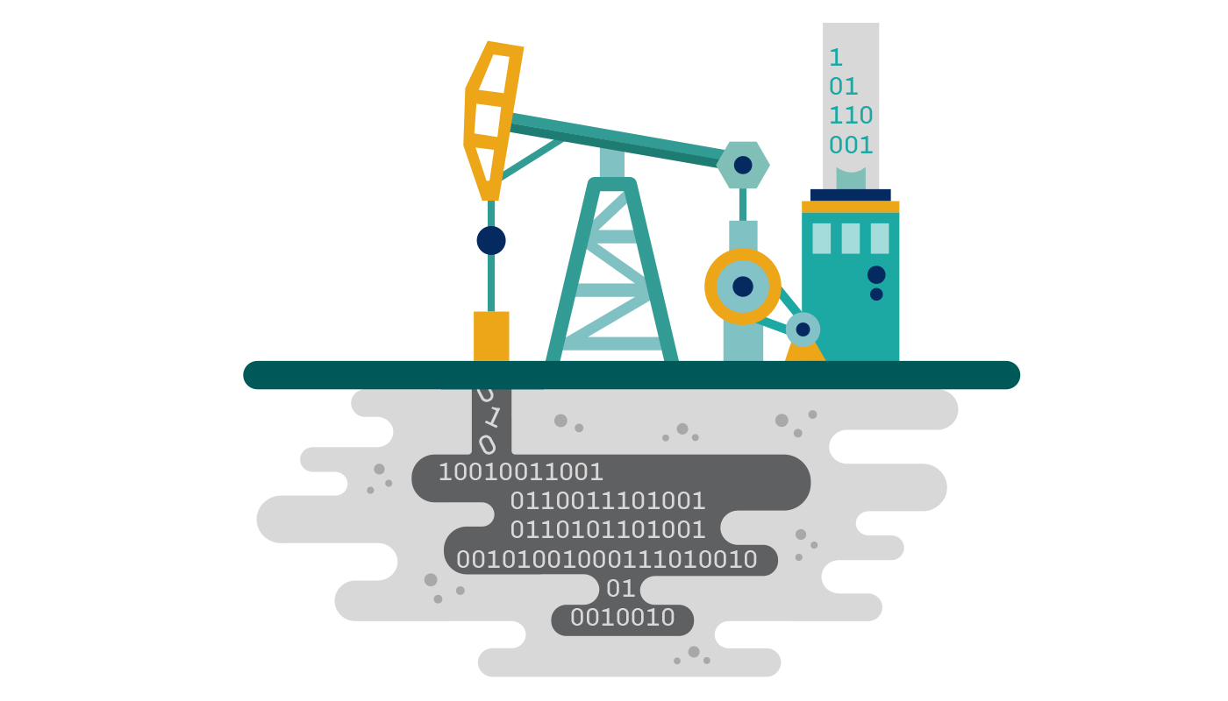
Why Data IS IMPORTANT ?
Make Informed Decisions
Get The Results You Want
Find Solutions To Problems
Back Up Your Arguments
Be Strategic In Your Approaches
Keep Track Of It All
Know What You Are Doing Well
DATA IS NEW OIL

Slide 14
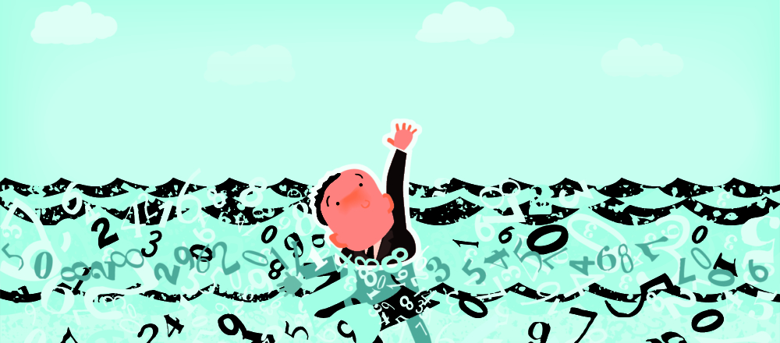
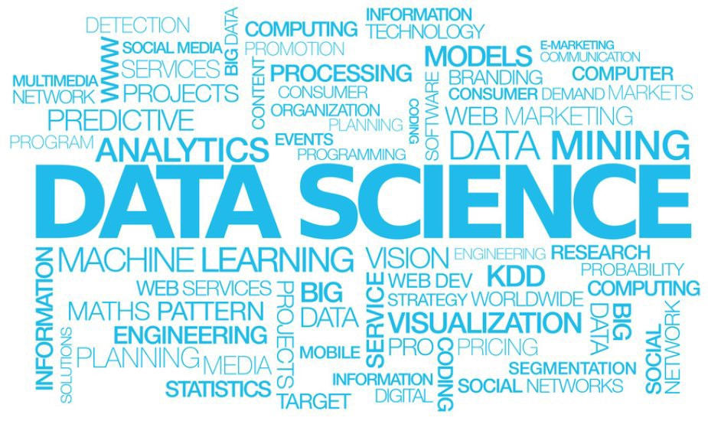
Reality ABOUT DATA
SOLUTION ?
We are now drowing in data ! but starving for insights ☹

Slide 15
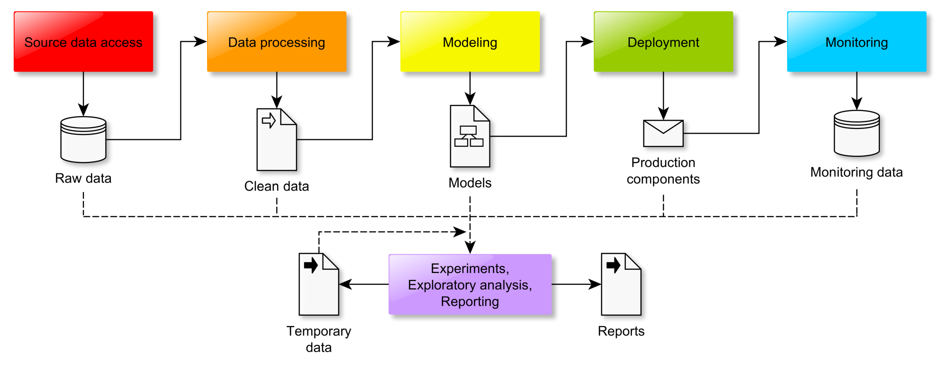
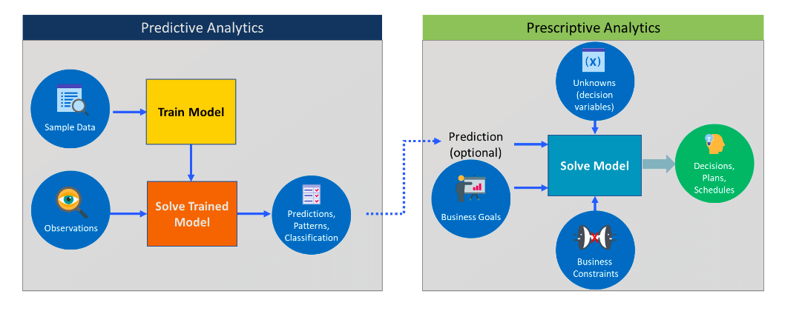
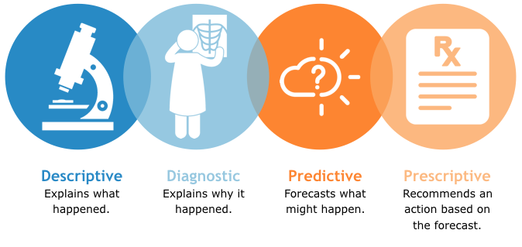
Data Science Pipeline

Slide 16
Confused ?

Slide 17
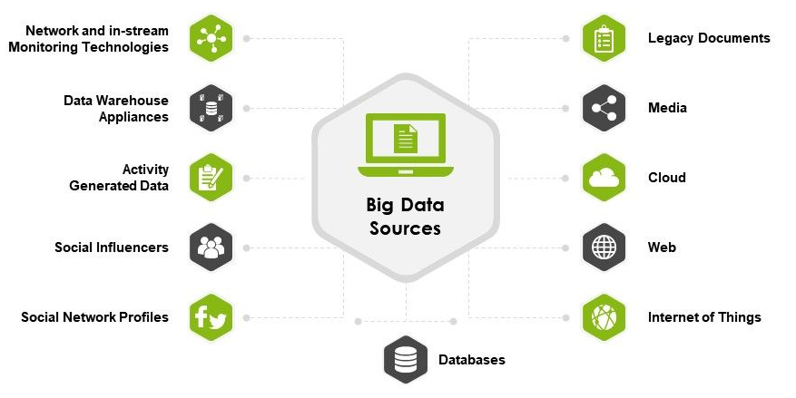
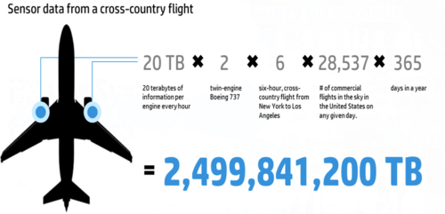
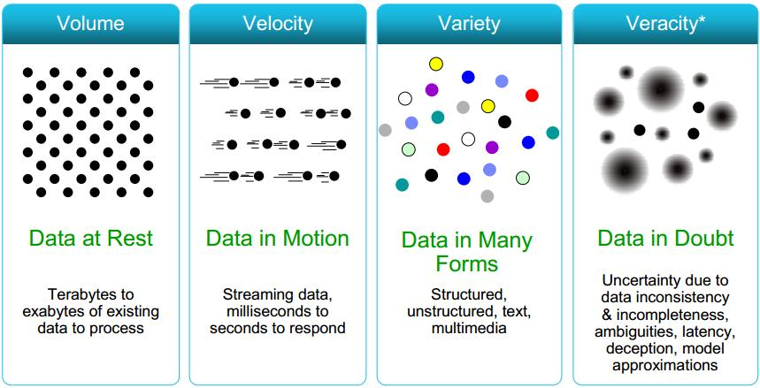
Big Data
Properties of Bigdata
Is Big Data = Large Data ?

Slide 18
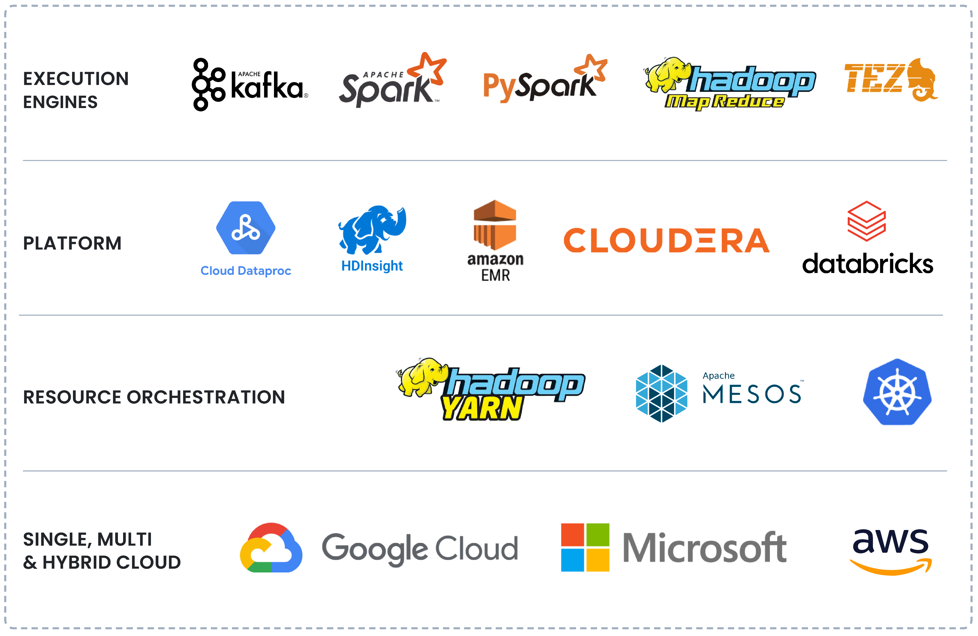
Big Data

Slide 19
What is machine learning?
“Learning is any process by which a system
improves performance from experience.”
- Herbert Simon
Definition by Tom Mitchell (1998):
Machine Learning is the study of algorithms that
- improve their performance P
- at some task T
- with experience E.
A well-defined learning task is given by <P,T,E>

Slide 20


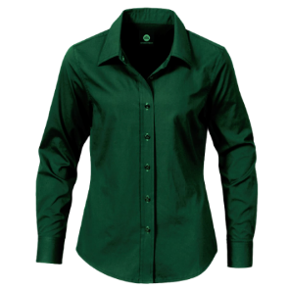
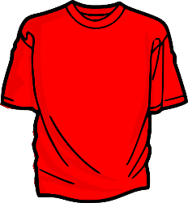
Color: Green
Size : Large
Type : Formal
This is a shirt we used to wear.
Color: Green, red
Size : Large, small
Type : Formal, casual
Color: Green
Size : Large
Type : Formal
Is this a shirt ?
Ok
No!
This is also a shirt

Slide 21
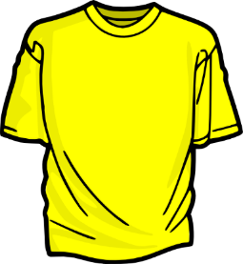
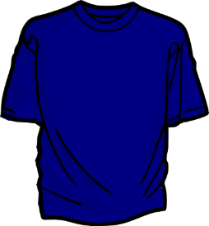


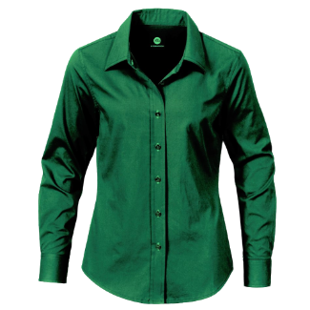
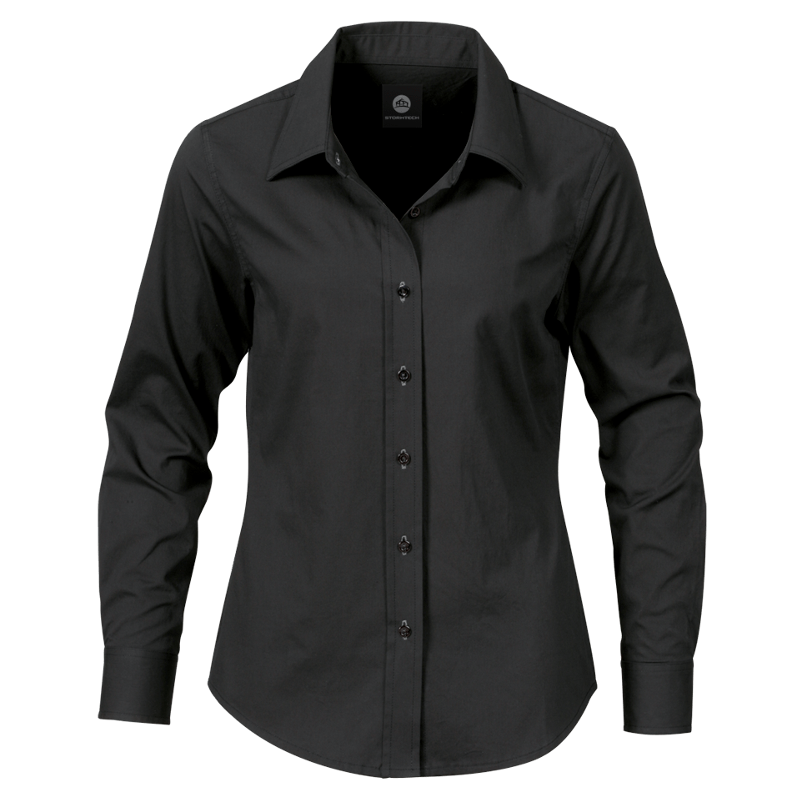
Color: Green, red
Size : Large, small
Type : Formal, casual
Color: Green, red, yellow
Size : Large, small, medium
Type : Formal, casual
Is this a shirt ?
Ok
No!
This is also a shirt
Now I can identify every shirt
Yes, these are all shirts

Slide 22
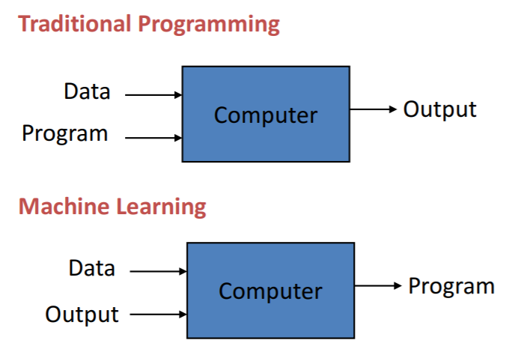
Programming vs Learning

Slide 23
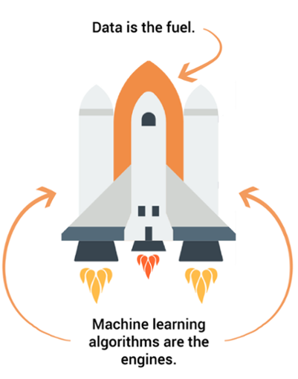
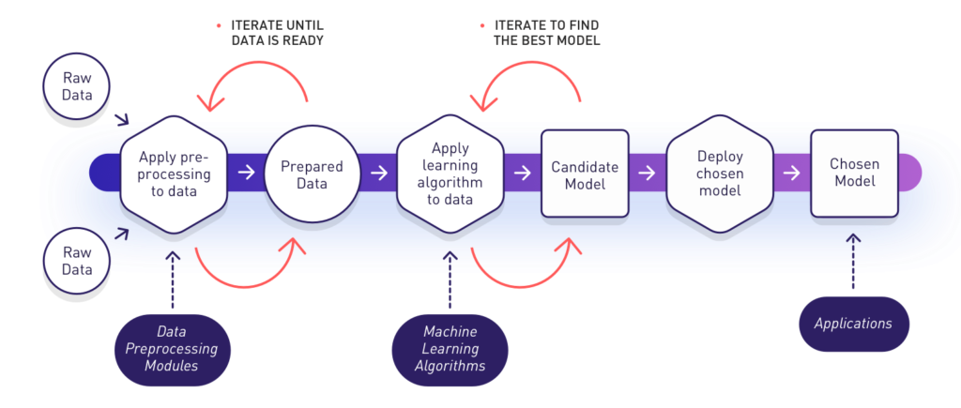
Machine Learning Pipeline

Slide 24
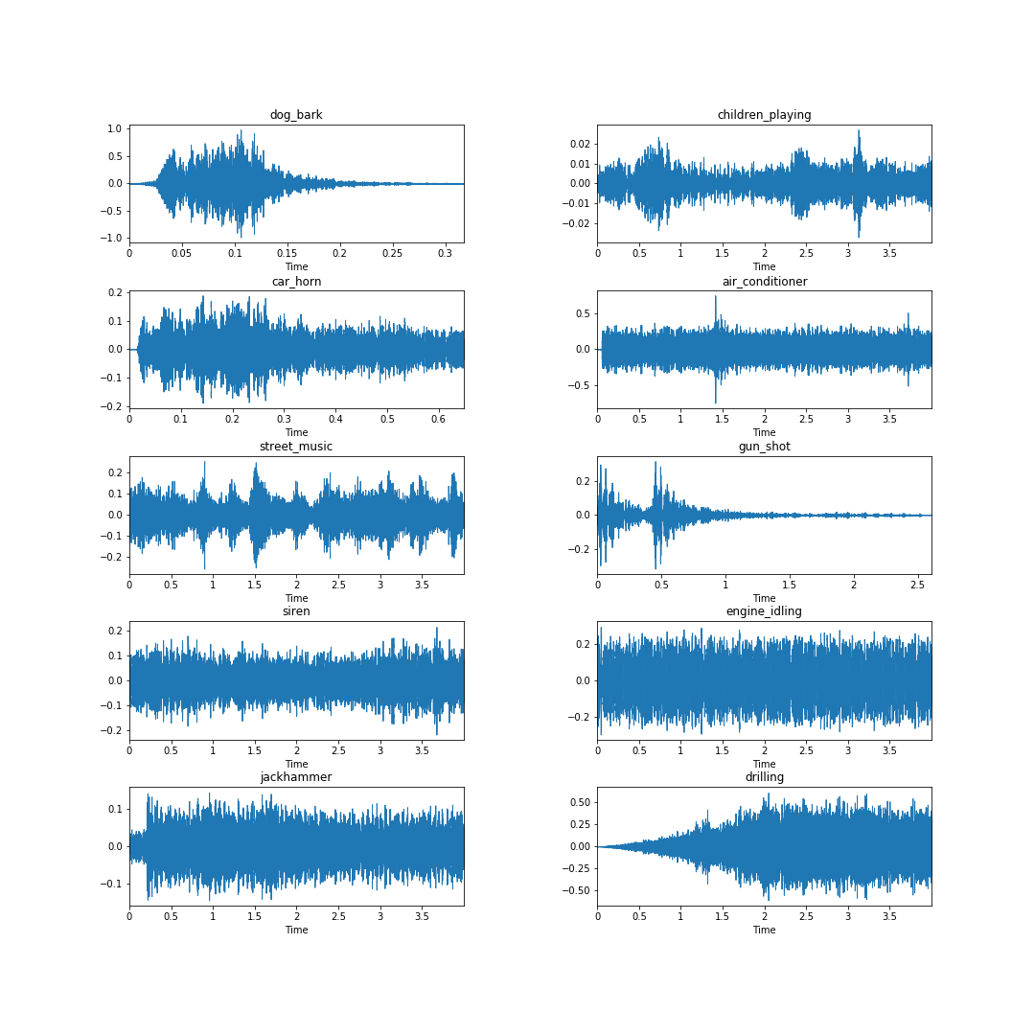
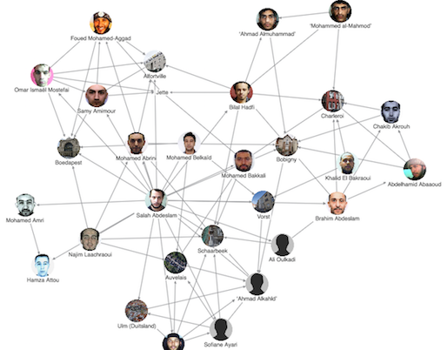
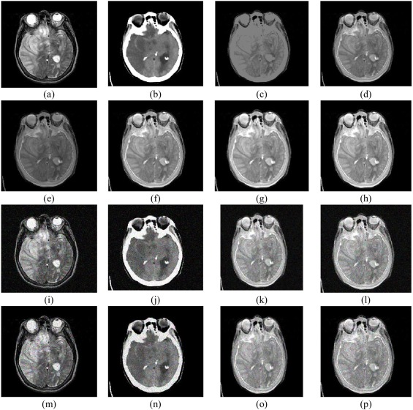
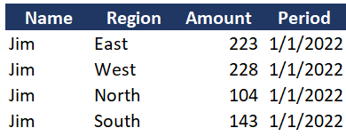
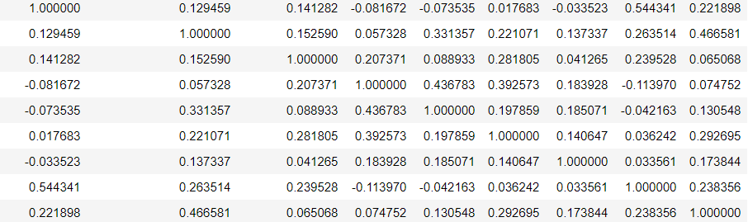
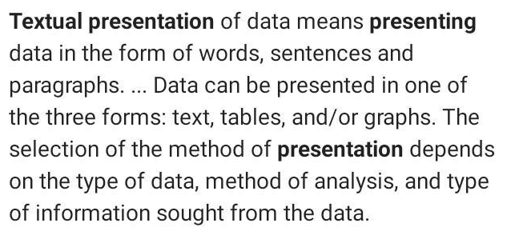
DATA as FEATURE VECTORS
Raw Data
Feature Engineering
Feature Vector

Slide 25
When to machine learning?
ML is used when:
Human expertise does not exist (navigating on Mars)
Humans can’t explain their expertise (speech recognition)
Models must be customized (personalized medicine)
Models are based on huge amounts of data (genomics)
Learning isn’t always useful - There is no need to “learn” to calculate payroll

Slide 26

Types of Learning

Slide 27
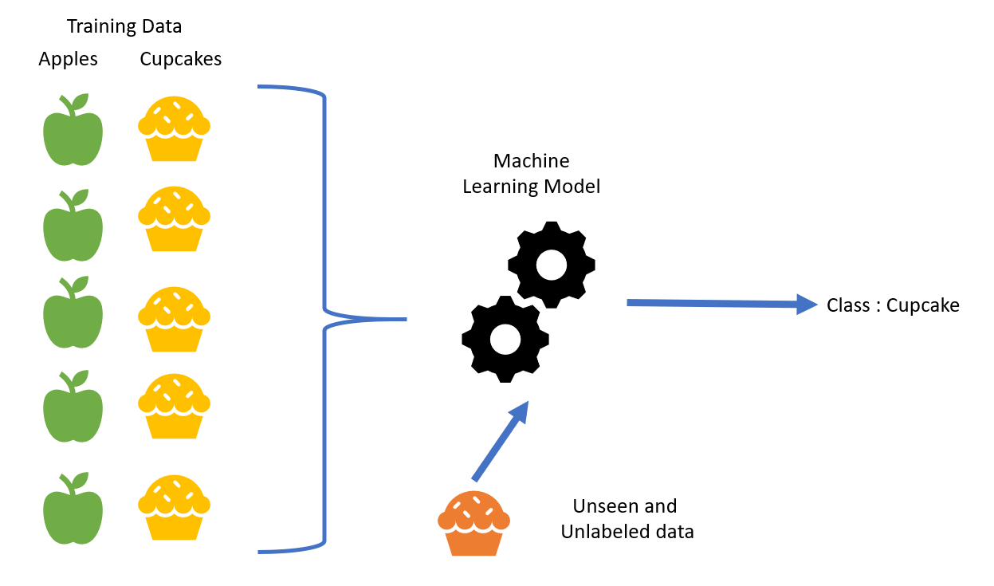

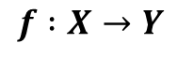
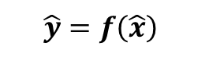
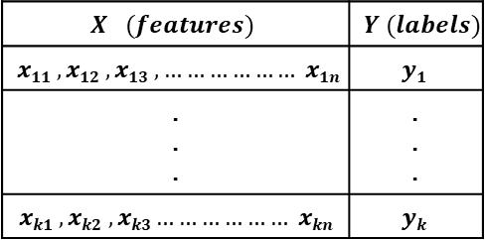
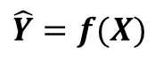
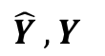
Supervised Learning
$$X (features)$$ | $$Y (labels)$$
$$x11 , x12 , x13 , ……………… x1n$$ | $$y1$$
. . . | . . .
$$xk1 , xk2 , xk3……………… xkn$$ | $$yk$$
Input : Labeled Data
Goal : Construct a predictor
to minimize the error between
where,
$$f :X→Y$$
$$\hat{Y} , Y$$
$$\hat{Y}=f(X)$$
Use : using predictor to predict
$$\hat{y}=f\left(\hat{x}\right)$$
For the unknown input
$$\hat{x}$$

Slide 28
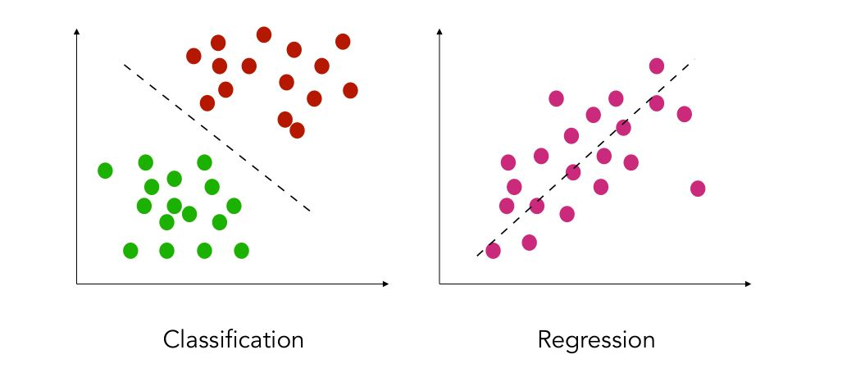

Supervised Learning
Classification
features and discrete labels
maps an input to discrete label(class)
Eg: spam or not, type of cancer
Regression
features and continues real values
Predict a real value for an input
Eg: gold price, temperature

Slide 29
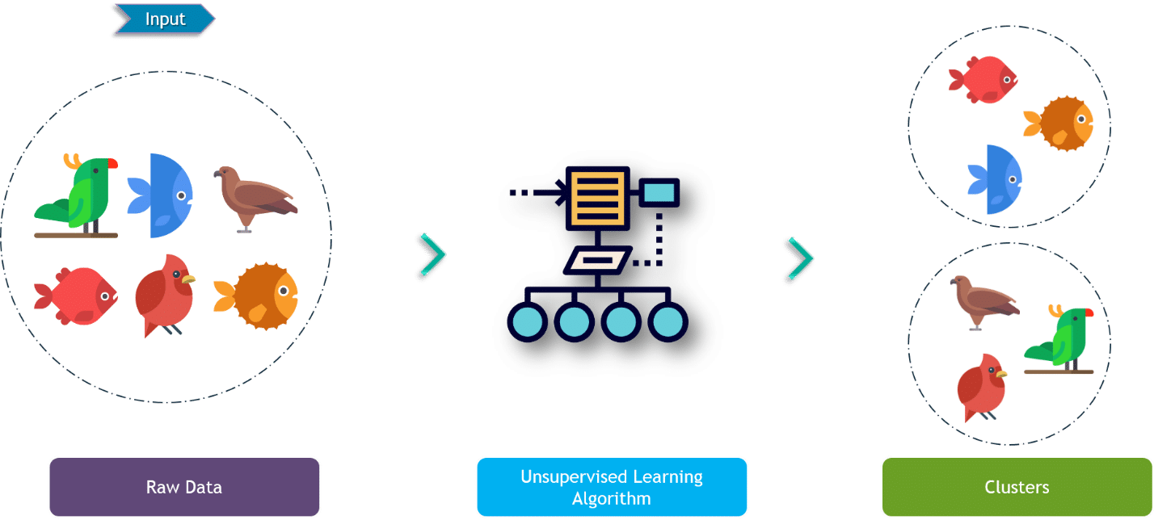
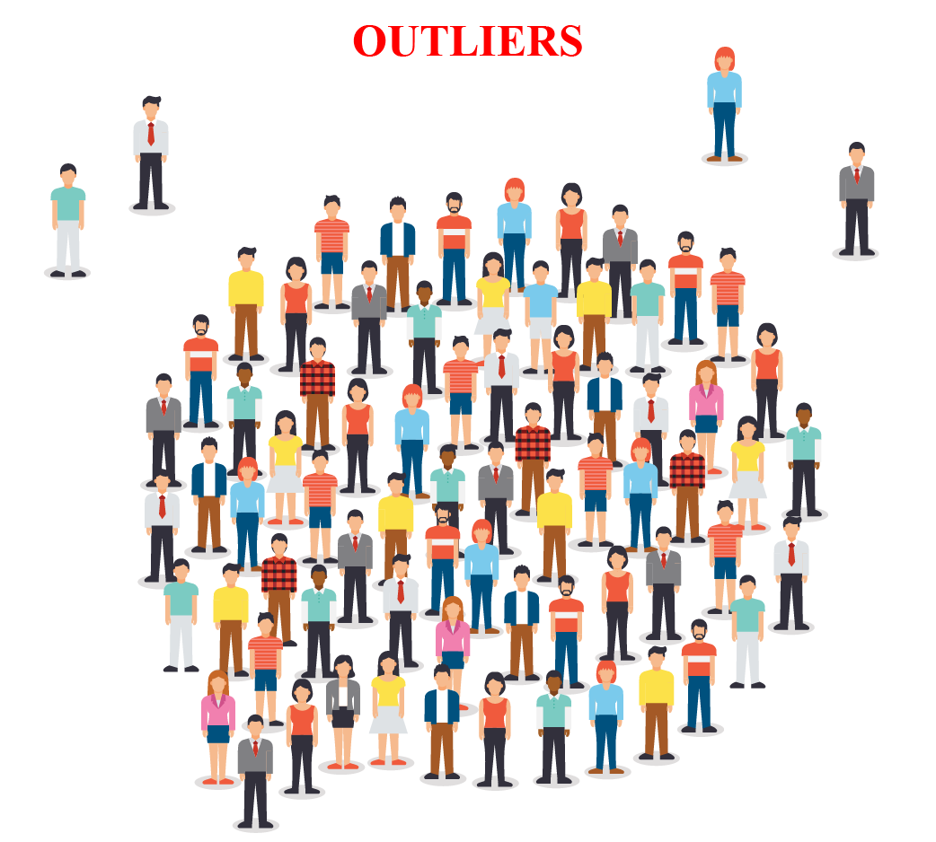
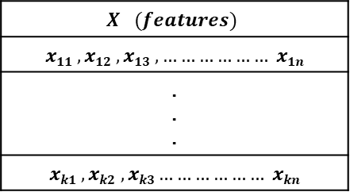
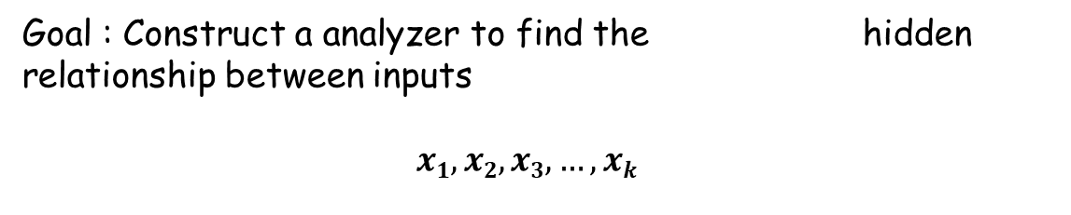
Unsupervised Learning
$$X (features)$$
$$x11 , x12 , x13 , ……………… x1n$$
. . .
$$xk1 , xk2 , xk3……………… xkn$$
Input : Unlabeled Data
Goal : Construct a analyzer to find the hidden relationship between inputs
$$x1, x2,x3,…,xk$$
Use : Group or associate inputs according to their similarity

Slide 30




Unsupervised Learning
Clustering
Itemset and rule mining

Slide 31

Reinforcement Learning
Use software agents
Based on rewards
Objective is to maximize rewards for better learning

Slide 32

Semi Supervised Learning
In a nutshell, semi-supervised learning (SSL) is a machine learning technique that uses a small portion of labeled data and lots of unlabeled data to train a predictive model

Slide 33





Dr. Shailesh Sivan
+91 8907230664
shaileshsivan@cusat.ac.in
https://shaileshsivan.info

Slide 34


